Slide 1
VIRTUAL MACHINE SCALE SET (VMSS)
MANOJ

Slide 2
Virtual Machine Scale Set (VMSS) :
Azure virtual machine scale sets let you create and manage a group of load balanced VMs. The number of VM instances can automatically increase or decrease in response to demand or a defined schedule.
Benefits with VMSS :
Easy to create and manage multiple VMs
Provides high availability and application resiliency by distributing VMs across availability zones or fault domains
Allows your application to automatically scale as resource demand changes

Slide 3
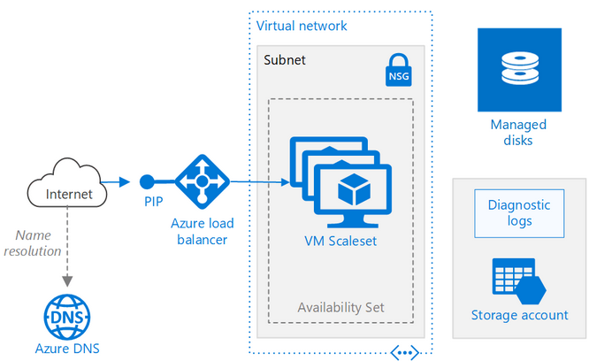

Slide 4
Auto-Scaling:
Auto-scaling is a way to automatically scale up or down the number of compute resources that are being allocated to your application based on its needs at any given time.
The key point is that you can now design a scalable architecture that will automatically scale-up or scale-down to meet your needs over the lifetime of your setup regardless of how fast/slow or big/small your site grows over that time.
Here are the most popular ways of auto-scaling:
1.Horizontal Scaling
2.Vertical Scaling

Slide 5
Vertical Scaling:
Vertical Scaling is an attempt to increase or decrease the capacity of a single machine, also called scaling up or down. Here the resources such as processing power, storage, memory, and more are added to an existing work unit.
It is done to increase the capacity of existing hardware or software by adding resources. It can enhance your server without manipulating your code. But it is limited by the fact that you can only get as big as the size of the server.
For example, you could move an application to a larger VM size.

Slide 6
Horizontal Scaling:
Horizontal Scaling is a must use technology – whenever a high availability of (server) services are required, also called scaling out and in, means adding or removing instances of a resource. Scaling horizontally involves adding more processing units or physical machines to your server or database.
It involves growing the number of nodes in the cluster, the application continues running without interruption as new resources are provisioned.
If demand drops, the additional resources can be shut down cleanly and deallocated.

Slide 7
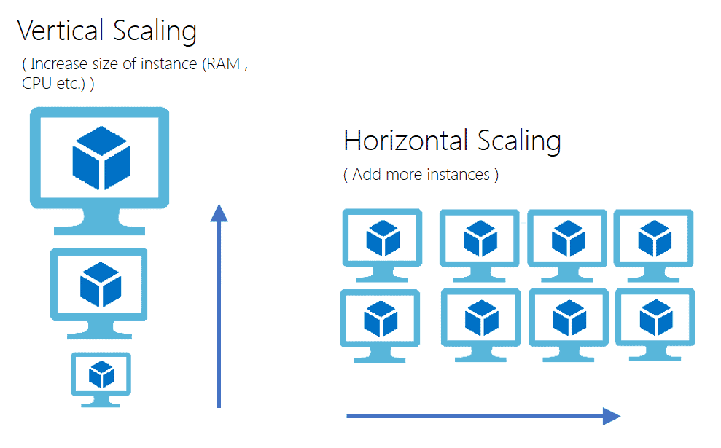

Slide 8
Autoscale Settings
An autoscale setting is read by the autoscale engine to determine whether to scale up or down.
You can create custom autoscaling rules as needed for your situation.
Rule types include:
Minimum Instance: The minimum number of instances you want to deploy in your scale set.
Maximum Instances: The maximum number of instances you want to deploy while scaling out. (Note: In Azure, you can have maximum, 1000 instances)
Metric-based – It measures application load and add or remove VMs based on that load. For example, add instance in scale set when CPU usage is above 50%.
Time-based – For example, trigger an instance every 8 am on Saturday in a given time zone.

Slide 9
Here are a few points which are important when we think about going with Horizontal scaling or Vertical Scaling.
Scaling up requires downtime, in this case, you need to upgrade server’s configuration like RAM, memory, CPU, etc. so while upgrading this configuration your server requires downtime. Once you are done with the update, the restart of the server is required.
Scaling up will Increase performance but not available because its only one instance and it can go down anytime when it reaches out the scaling rules.
Scale-Out doesn’t require downtime, in Scale-out its creates new instances of server it doesn’t touch the existing instance, so no downtime required.
Scale-Out, Increase performance and availability as well. When auto-scaling increase no. of instances and handle load/request using load balancer it increases the performance of the server and also increases availability as well.

Slide 10
Lab: Create Virtual Machine Scale Set
Select Create on the Virtual machine scale sets page. The Create a virtual machine scale set will open.
Select the subscription that you want to use for Subscription.
For Resource group, select Create new and type manoj-rg for the name and then select OK.

Slide 11
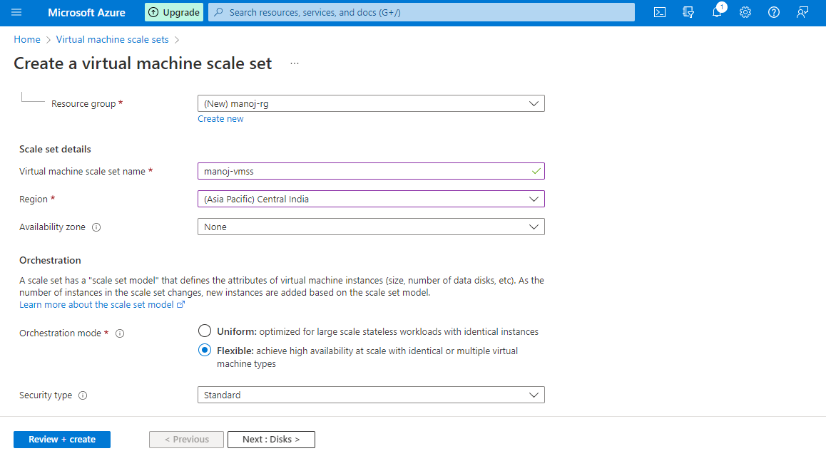

Slide 12
For Virtual machine scale set name, type manoj-vmss.
For Region, select a region that is close to you like Central India.
Leave Availability zone as blank for this .
For Orchestration mode, select Flexible.

Slide 14
For Image, select Windows Server 2022 Datacenter - Gen 2.
For Size, select a size like Standard_B1s_1 vpcu.
For Username, type the name to use for the administrator account, like manojuser.
In Password and Confirm password, type a strong password for the administrator account.

Slide 15
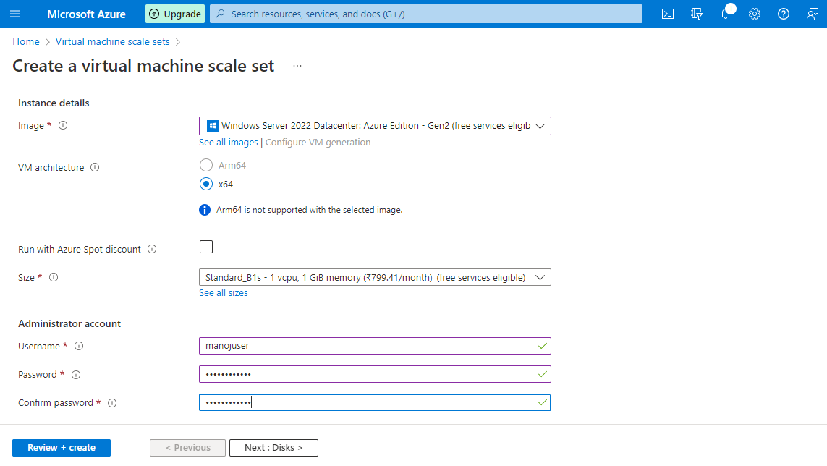

Slide 16
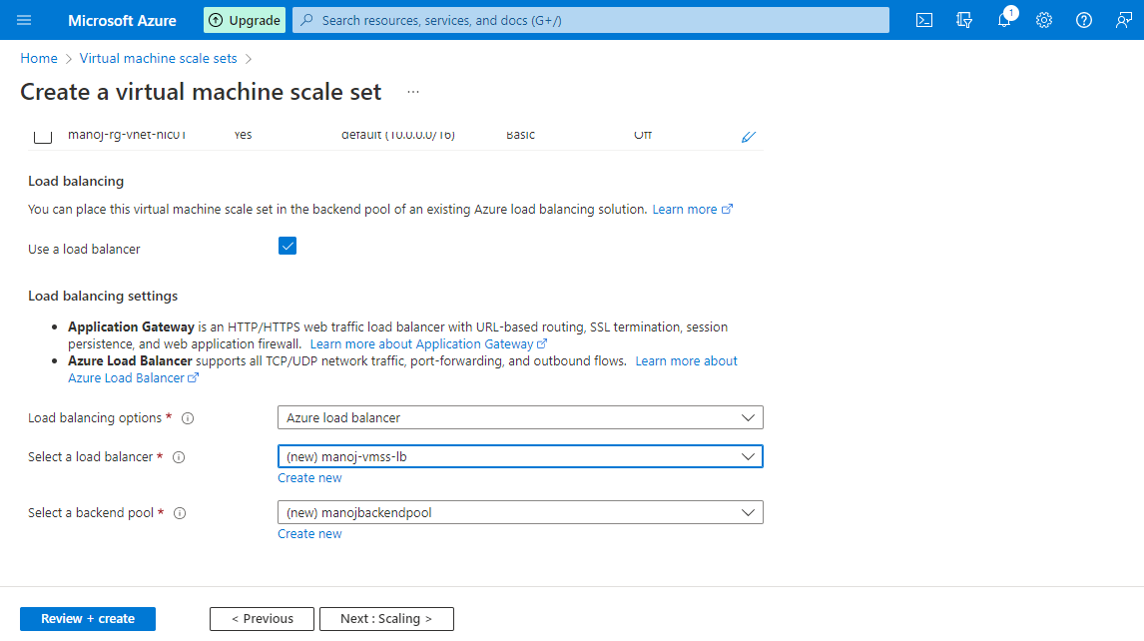
On the Networking tab, under Load balancing, select Use a load balancer.
For Load balancing options, leave the default of Azure load balancer.
For Select a load balancer, select Create new.

Slide 17
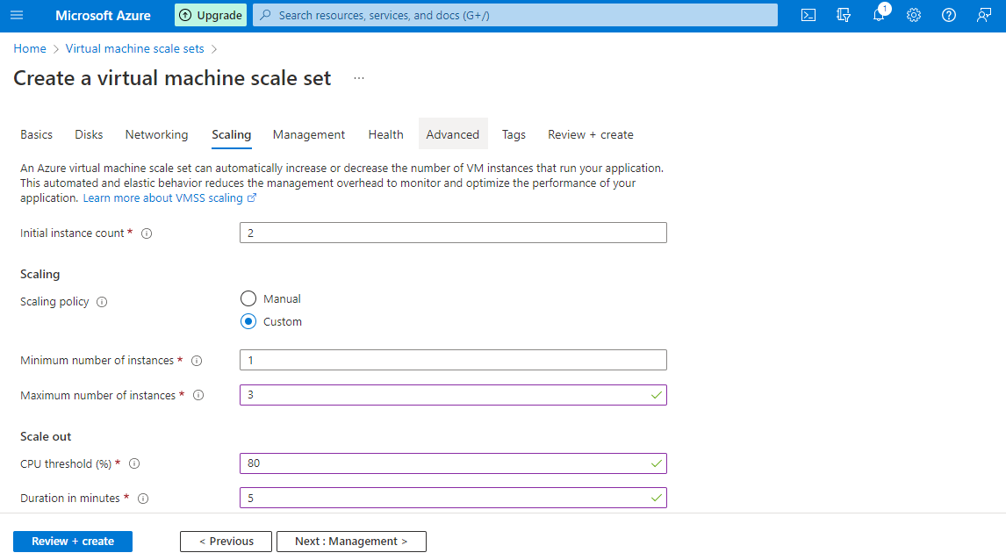
On the Scaling tab, leave the default instance count as 2, or add in your own value. This is the number of VMs that will be created, so be aware of the costs and the limits on your subscription if you change this value.
Scaling policy set to Custom.

Slide 18
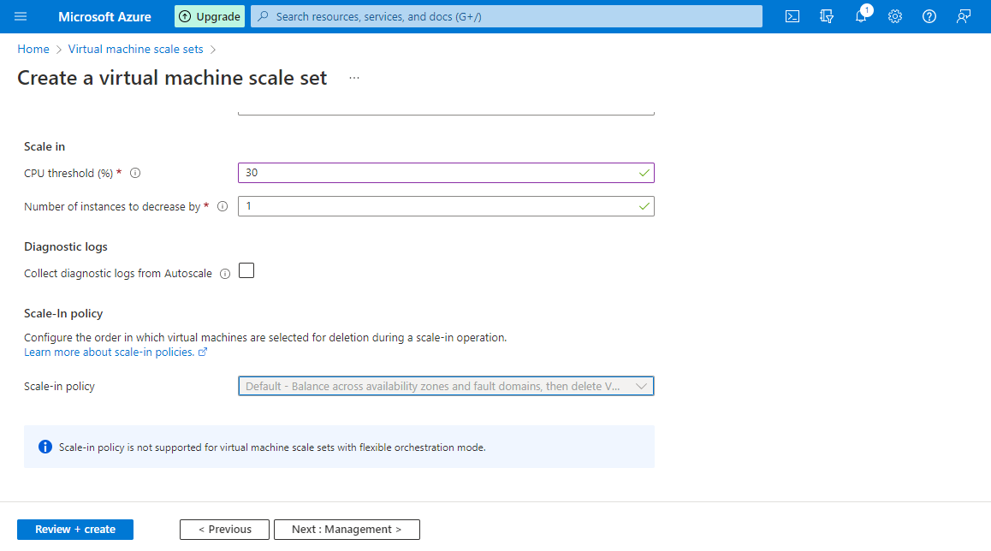

Slide 19
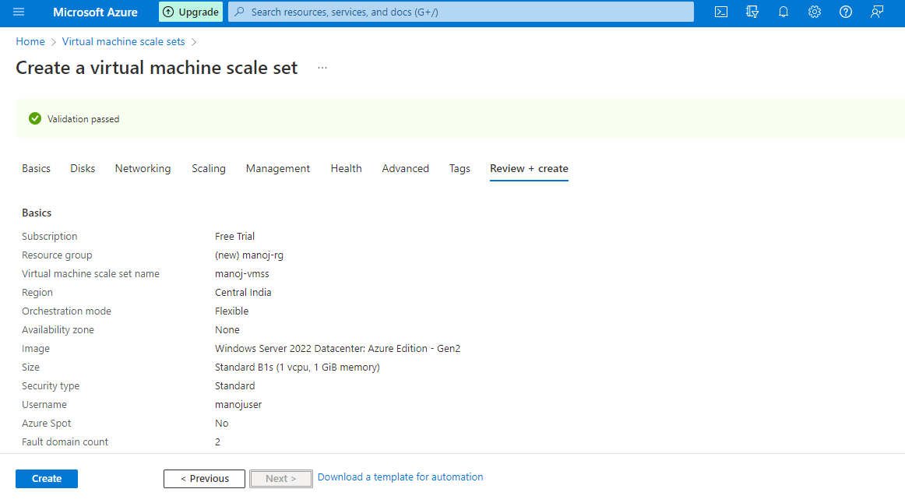

Slide 20
When you are done, select Review + create.
Once you see that validation has passed, you can select Create at the bottom of the page to deploy your scale set.
When the deployment is complete, select Go to resource to see your scale set.

Slide 21
View the VMs in your scale set
You will see a list of VMs that are part of your scale set. This list includes:
The name of the VM
The computer name used by the VM.
The current status of the VM, like Running.
The Provisioning state of the VM, like Succeeded.

Slide 22
